Slide 1
CS 2212
Introduction to Software Engineering
Chapter 11 Component Level Design

Slide 2
Copyright Notice This Presentation and Its Associated Video Contain Copyright Material. This Presentation and Its Associated Video Are Provided for Teaching Purposes of CS2212 and Should Not Be Posted In Any External Site, Or Shared with. This Presentation and Its Associated Video Are Provided For Instructional Personal Use Only, and Only For The Purposes of the CS2212 Course.

Slide 3
Part 28
UML Component Diagrams
Simplicity is the ultimate sophistication.
― Leonardo da Vinci.
Notes:
This lesson introduces the basic steps in a software engineering project at a high level.
In practice, steps often overlap.

Slide 4
Learning Objectives in this Part
To understand the notation and semantics of UML Component Diagrams and UML Deployment Diagrams

Slide 5
Modeling with UML
Requirements Modeling | Scenarios, Use Case Diagrams
Static Modeling | Class Diagrams Object Diagrams Component Diagrams Deployment Diagrams
Dynamic Modeling | Sequence Diagrams Collaboration Diagrams – Communication Diagrams στη UML 2.0
Modeling the behavior of specific objects/classes | State Diagrams
Modeling the execution of system process steps | Activity Diagrams
Modeling system
operation – user’s
view
System
Structure
Modeling
System
Behavior Modeling

Slide 6
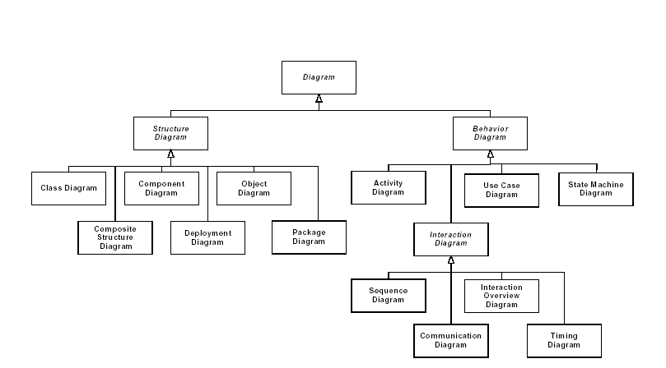
UML 2.0 Diagrams Structure

Slide 7
What is a Component?
The Unified Modeling Language Specification defines a component as:
“… a modular, deployable, and replaceable part of a system that encapsulates implementation and exposes a set of interfaces”
A component contains processing logic, the internal data structures that are required to implement the processing logic, and an interface that enables the component to be invoked and data to be passed to it
In the context of object-oriented software engineering, a component is a container for a set of collaborating classes (and, in some cases, a component may contain just a single class)

Slide 8
Hierarchy of Units
Systems
Subsystem
Component
Composite Component
Class
System
Subsystem
1
*
1
*
Component
*
Class
Composite Components
1

Slide 9
Component Diagrams
These diagrams model the structure of the system as a collection of components which interact using specific interfaces and exchange messages through these interfaces
A Component is:
A system unit that offers specific functionality and services and obeys to specific communication protocols with other components
A component is referred to by a mnemonic name and hide their implementation details. They only expose interfaces
A good design has components with high cohesion and low coupling

Slide 10
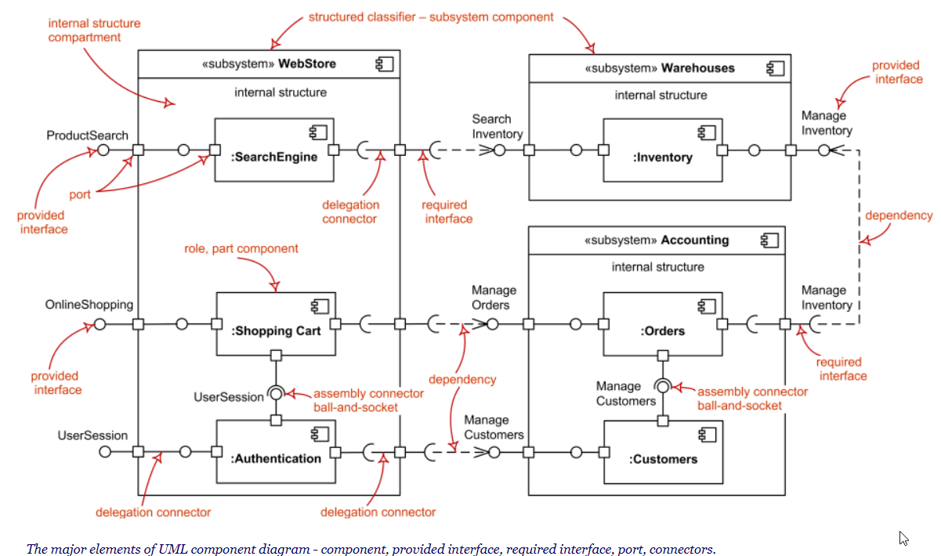
UML Component Diagram Notation

Slide 11
Component Diagram Example in UML 1.x

Slide 12
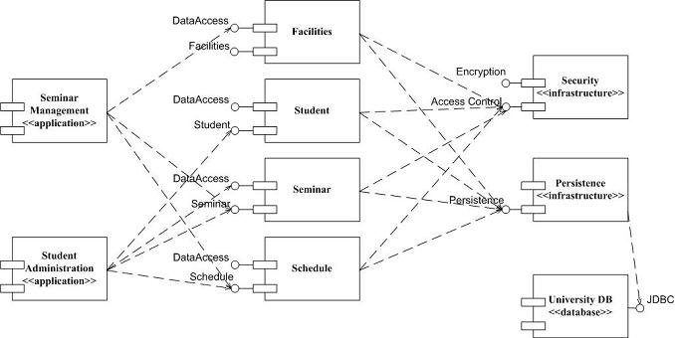
Component Diagram Example in UML 1.x
http://www.agilemodeling.com/artifacts/componentDiagram.htm

Slide 13
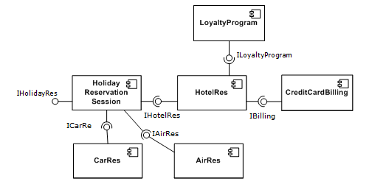
Component Diagram Example in UML 1.x
https://en.wikipedia.org/wiki/Component-based_software_engineering#/media/File:Component-based-Software-Engineering-example2.png

Slide 14
Part 29
Identifying and Designing Components
A designer knows that he has achieved perfection not when there is nothing left to add, but when there is nothing left to take away.
― de Saint-Exupery's Law of Design.
Notes:
This lesson introduces the basic steps in a software engineering project at a high level.
In practice, steps often overlap.

Slide 15
Learning Objectives in this Part
To understand the process of identifying and forming Components

Slide 16
How Do We Identify Components?
Step 1. Start from classes identified in the domain model and extend/ define design-level classes which are relevant to the application domain. These are referred to as domain-specific classes.
Step 2. Grouping of domain-specific classes into cohesive components referred to as domain components stereotyped as <<domain>>. The grouping is based on the concept that the methods of the classes being grouped should be relevant with each other so that high cohesion is maintained
Step 3. Classes which generate requests are referred to as client classes
Step 4. Classes that only offer specific types of services are referred to as server classes
http://agilemodeling.com/artifacts/componentDiagram.htm

Slide 17
How Do We Identify Components?
Step 5. Identification and grouping of client classes that invoke the functionality that is specific to the system’s requirements. These components are signified by the stereotype <<application>>.
Note that client classes most probably belong to <<application>> components and not in <<domain>> components. The classes in the domain components they usually receive messages and initiate processes and services (i.e. are server classes)
Step 6. Identification and grouping of classes that implement low level system operations (e.g. security services, interoperability services, middleware services). These components are signified by the stereotype <<infrastructure>>
Step 7. Grouping of classes that have a generalization/specialization relation or a composition/aggregation relation, to the same component

Slide 18
How Do We Identify Components?
Step 8. Association of user interface classes (or cohesive groups thereof) which implement input/output operations with application components. These are most probably <<application>> type components
Step 9. Identification of interfaces between components (i.e. component interfaces)
Step 10. Classes with high cohesion or classes that exchange many messages belong to the same component
Step 11. Regrouping and fine tuning of the design to achieve the minimization of messages exchanged between components

Slide 19
Component Diagram Example in UML 1.x
http://www.agilemodeling.com/artifacts/componentDiagram.htm

Slide 20
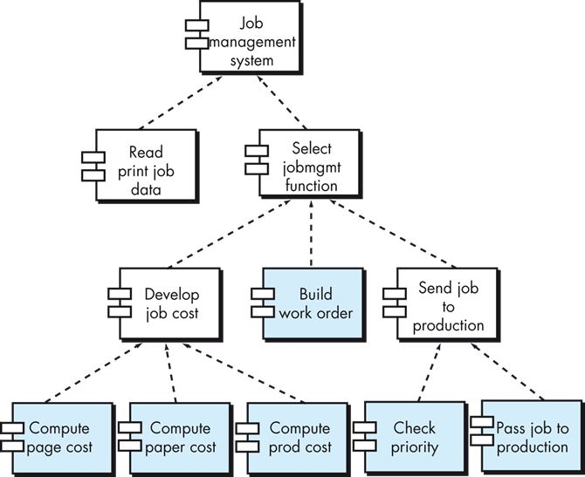
Elaboration of Components: Example
Consider a structural diagram for a printing system following a call and return architectural style. Several components have been identified and we can get a feeling for the overall flow and functioning of the system. That said, we are missing detail essential to implementation and so elaboration of the various components is necessary.

Slide 21
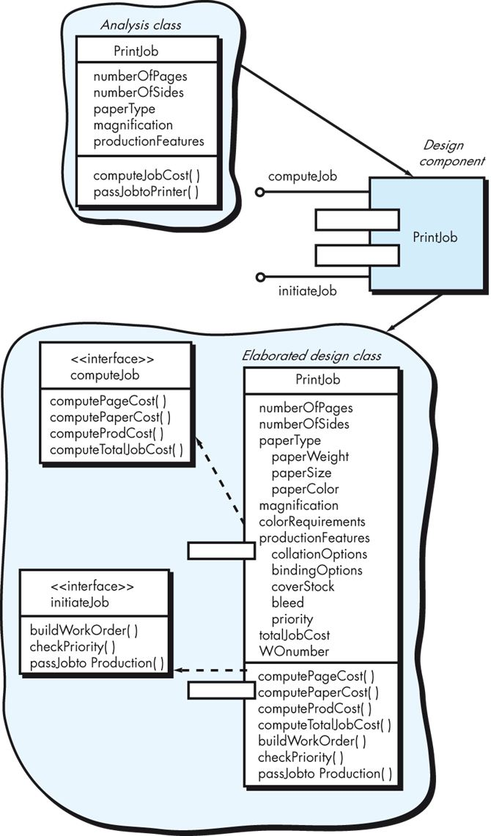
Elaboration of Components: Example
An elaborated component for a print job. We start with the analysis class from requirements engineering and define that as a design component using the UML shorthand in the diagram. In doing so, we identify two interfaces that must be supported, computeJob and initiateJob to cost out printing and send the job to production. (We use the
“lollipop” symbols to denote the interfaces.)
We then elaborate on this design, adding additional attributes and operations to provide sufficient information for implementation. This includes adding details to the interfaces, and may include adding support classes like a JobQueue (not shown)
to queue up jobs sent to production.

Slide 22
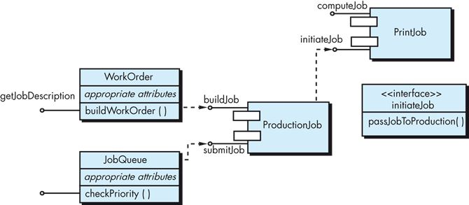
Component-Level Design
A refactored set of interfaces and classes for PrintJob. On
closer inspection, the interface for initiateJob introduced earlier did not seem cohesive as it performed three different subfunctions. So, new WorkOrder and JobQueue classes were added to refactor the code and bring focus to initiateJob.

Slide 23
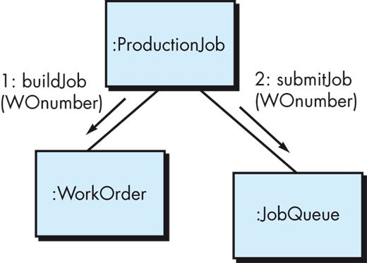
Component-Level Design
Collaboration diagram from our earlier printing example, with messaging details shown. In this case, sequence numbers show the order of messages, names of operations are given (buildJob and submitJob) and an argument list is given (a WOnumber).

Slide 24
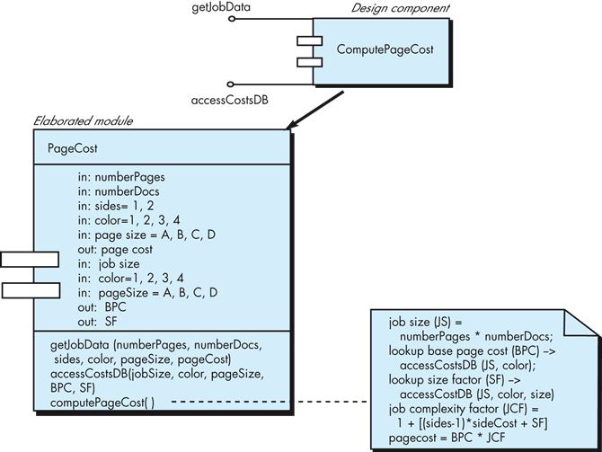
Elaboration of Components: Example
Taking things further, lets consider the elaboration of the component that computes page cost. We can drill down further into more details of attributes and operations, eventually arriving to the point where pseudocode is defined for operations. (We could also use a UML activity diagram or flowchart for this instead.)

Slide 25
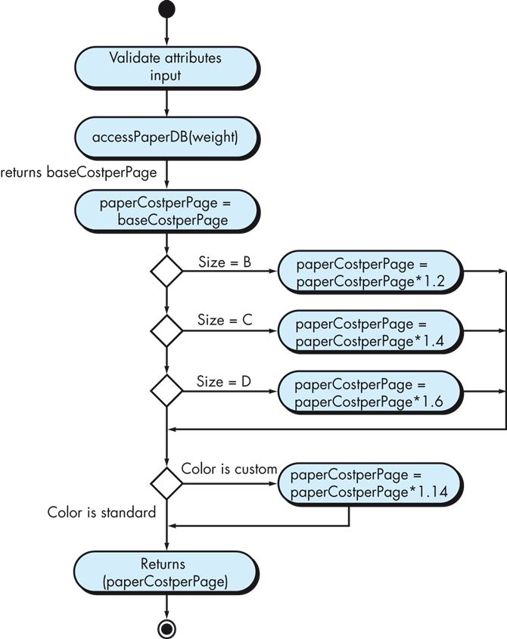
Component-Level Design
Activity diagram representing the algorithm behind computePaperCost(). If an algorithm behind an operation is simple and well understood, elaboration in an activity diagram might not be necessary. Since some custom processing based on paper size and color is needed here, it’s best to present the logic in more detail in a separate diagram.

Slide 26
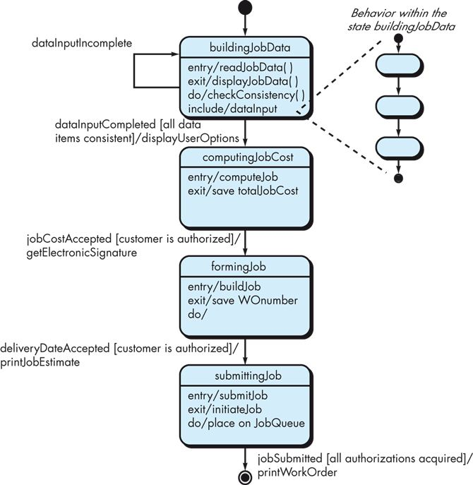
Component-Level Design
Partial state diagram for the PrintJob class. Here, we have identified the various states, the events that trigger transitions, and guards that dictate conditions that must be met for the transitions to occur. We have also specified “entry” and “exit” actions that occur as flow transitions in or out of a state, as well as “do” actions that occur while in the state. We can also use an “include” indicator to elaborate behavior by embedding more detail within a state.

Slide 27
Part 30
Component, Deployment and Package Diagram Examples
So much complexity in software comes from trying to make one thing do two things.
― Ryan Singer.
Notes:
This lesson introduces the basic steps in a software engineering project at a high level.
In practice, steps often overlap.

Slide 28
Learning Objectives in this Part
To go over and discuss examples of Component Diagrams, Deployment Diagrams, and Package Diagrams

Slide 29
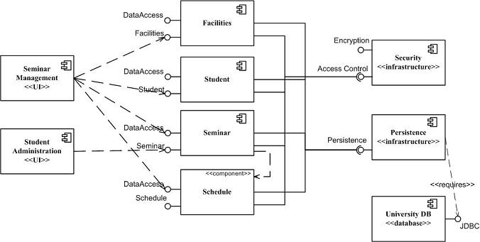
Component Diagram Example in UML 2.x
http://www.agilemodeling.com/artifacts/componentDiagram.htm

Slide 30
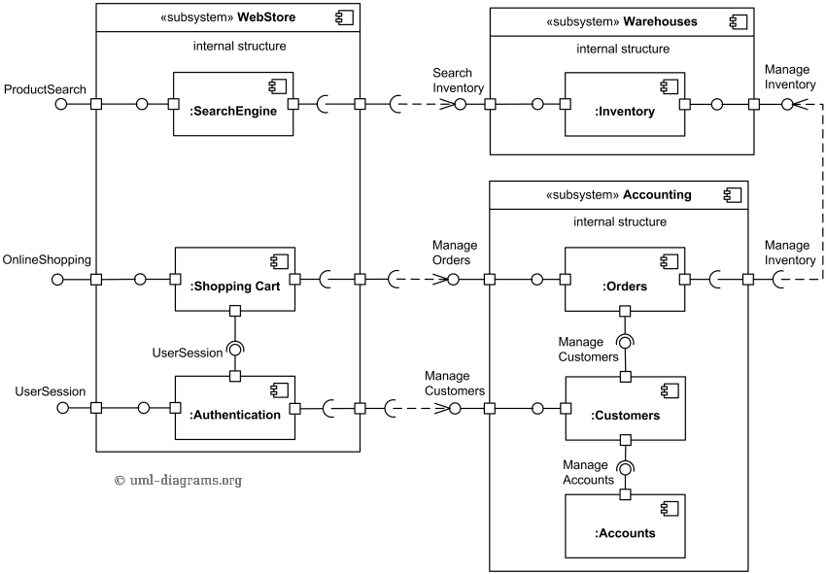
Component Diagram Example
Purpose: An example of a component diagram for online shopping.
Summary: The diagram shows "white-box" view of the internal structure of three
related subsystems - WebStore, Warehouses, and Accounting.
WebStore subsystem contains three components related to online shopping -
Search Engine, Shopping Cart, and Authentication.
Accounting subsystem provides two interfaces - Manage Orders and Manage Customers.
Warehouses subsystem provides two interfaces Search Inventory and
Manage Inventory used by other subsystems.
https://www.uml-diagrams.org/component-diagrams-examples.html

Slide 31
Deployment Diagrams
They denote and specify how the components will be physically deployed
Deployment diagrams show in which computational nodes (i.e. servers, data centers etc.) the different components or subsystems run and execute
In other words, these diagrams show how the system will have to be deployed in a specific hardware infrastructure

Slide 32
Example of Deployment Diagram
:Client
<<browser>>
:OpenSourceBrowser
videoStoreServer:AppServer
<<Container>>
VideoStoreApplication
<<Session>>
<<Entity>>
ShoppingSession
Catalog
<<Focus>>
<<Focus>>
ShoppingSession
Catalog
<<Entity>>
ShoppingCart
<<Focus>>
ShoppingCart
:DBServer
<<database>>
:VideoStore
DB

Slide 33
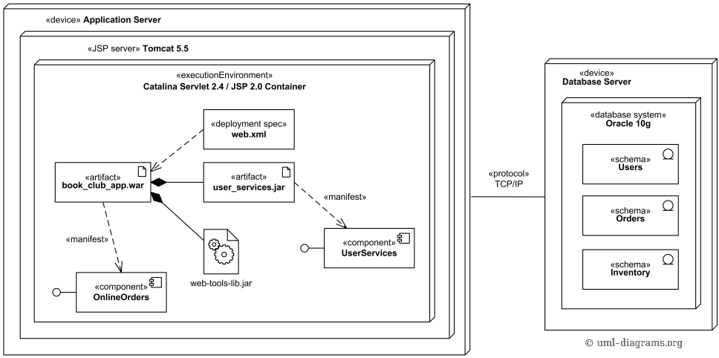
UML Deployment Diagram
An example of web application UML deployment diagram.
Book club web application artifact book_club_app.war is deployed on Catalina Servlet 2.4 / JSP 2.0
Container which is part of Apache Tomcat 5.5 web server.
The book_club_app.war artifact manifests (embodies) OnlineOrders component.
The artifact contains three other artifacts, one of which manifests UserServices component.
The Application Server «device» (computer server) has communication path to
Database Server «device» (another server).

Slide 34
Package Diagrams
They allow for grouping of classifiers in order to facilitate the easier comprehension of the system’s structure
The packaging is a way to facilitate grouping of related units and many times also reflects basic design decisions

Slide 35
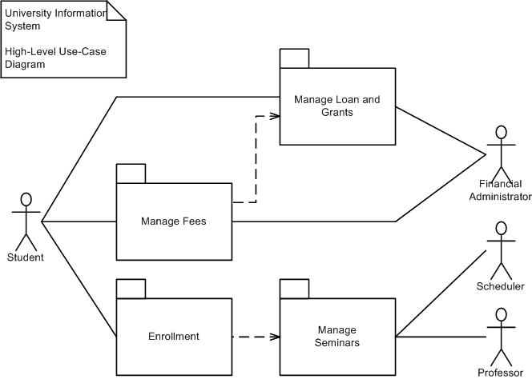
Package Diagram Example
http://www.agilemodeling.com/artifacts/packageDiagram.htm

Slide 36
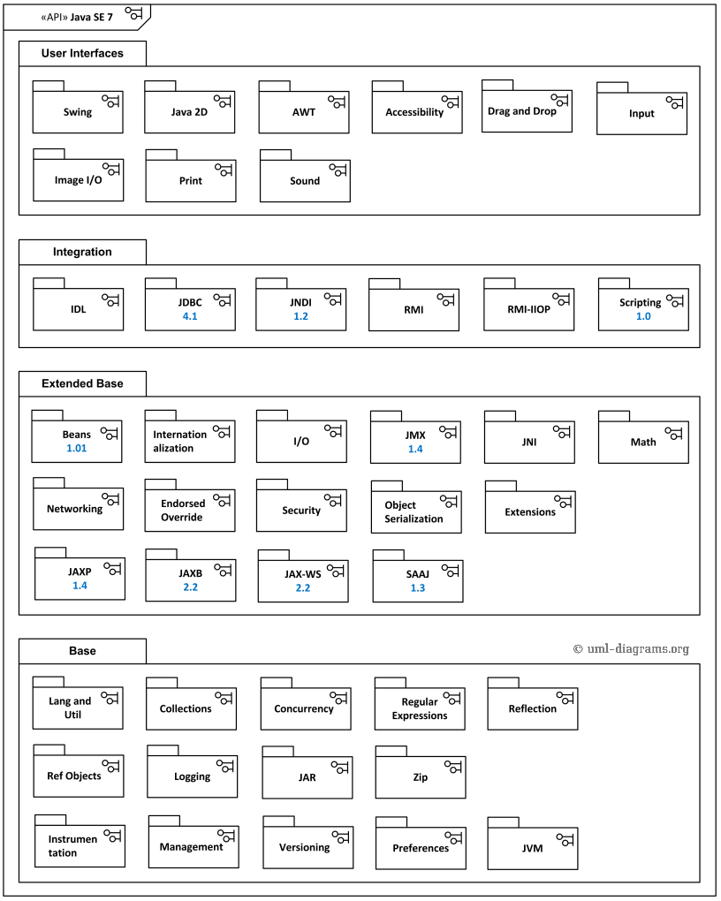
UML Package Diagram Example

Slide 37
Your Turn
Draft a Component Diagram of the SafeHome application depicting the exposed interfaces for each component you define. Make sure you comply with the cohesion and coupling design principles. Provide a list of the operations exposed by each interface (remember an interface is a collection of cohesive operations).
Check-out the content of the following sites:
https://www.uml-diagrams.org/component-diagrams.html
http://agilemodeling.com/artifacts/componentDiagram.htm
https://en.wikipedia.org/wiki/Component_diagram
https://www.infoq.com/articles/crafting-architectural-diagrams/

